Slide 1
An Introduction to Machine Learning from Time Series: Time Series Segmentation
ECML/PKDD, 09.09.2024, Vilnius, Lithuania
Arik Ermshaus, Patrick Schäfer

Slide 2
Table of Contents
Time Series Segmentation Task & Use Cases
Algorithms
Benchmark Data Sets
Open Problems & Future Work
Ermshaus, Schäfer - An Introduction to Machine Learning from Time Series: Time Series Segmentation

Slide 3
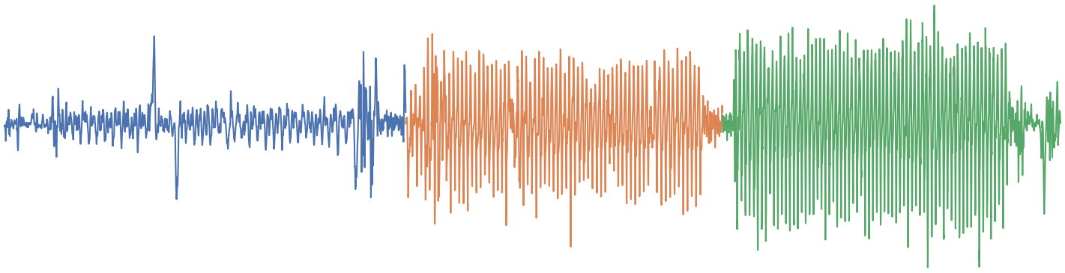
Time Series Segmentation (TSS)
1st split at
3.8k
2nd split at
6.8k
jog
run
walk
Y-axis Gyroscope recording (left calf)
Banos, O., Toth, M. A., Damas, M. et al. (2014). Dealing with the effects of sensor displacement in wearable activity recognition.
TSS partitions TS into variable-sized meaningful segments; based on change points
Notion of “meaningful” depends on domain
Complex unsupervised preprocessing for TS knowledge discovery
Ermshaus, Schäfer - An Introduction to Machine Learning from Time Series: Time Series Segmentation

Slide 4
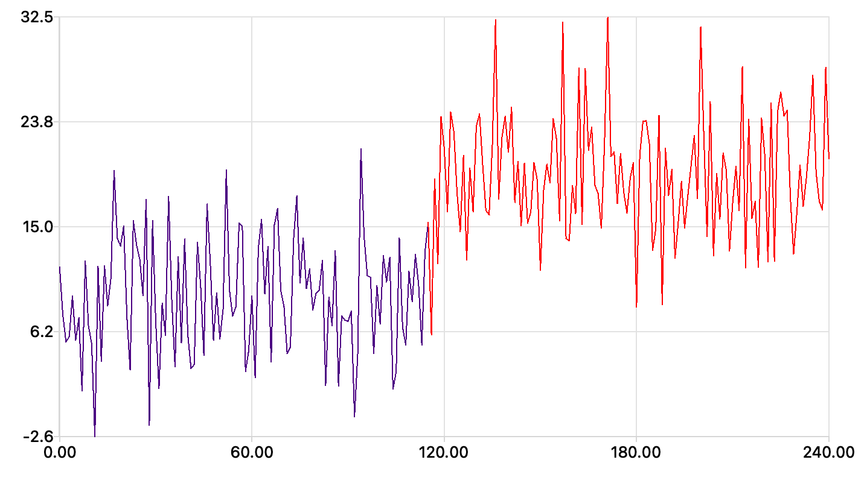
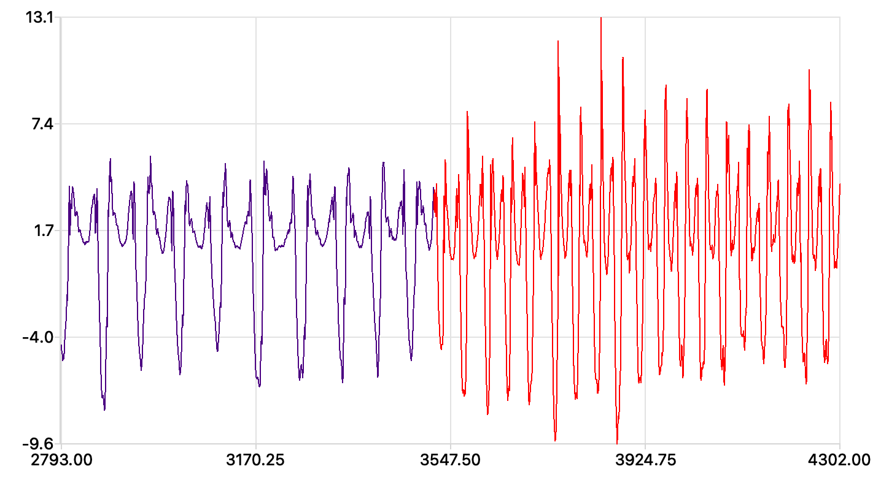
TSS: Types of Temporal Changes
Changes in distributions
Piecewise statistics
e.g. mean, var, trend
Changes in shape
Recurring temporal patterns
e.g. walking vs. running
Ermshaus, Schäfer - An Introduction to Machine Learning from Time Series: Time Series Segmentation

Slide 5
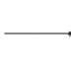

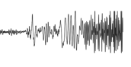
TSS in Data Mining Applications
Preprocessing
Segmentation
Downstream Task
Sensor Data
Step 1
Step 2
Step 3
TSS applied to partition preprocessed TS for knowledge discovery
Preprocessing: domain-specific, sensor artefacts, missing values
Downstream tasks: classification, clustering, anomaly detection
Ermshaus, Schäfer - An Introduction to Machine Learning from Time Series: Time Series Segmentation

Slide 6
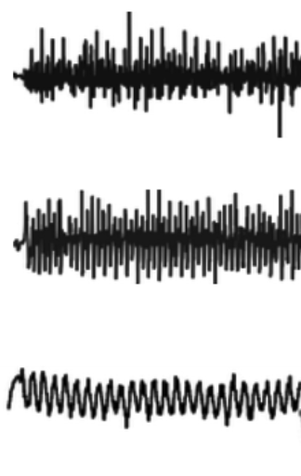

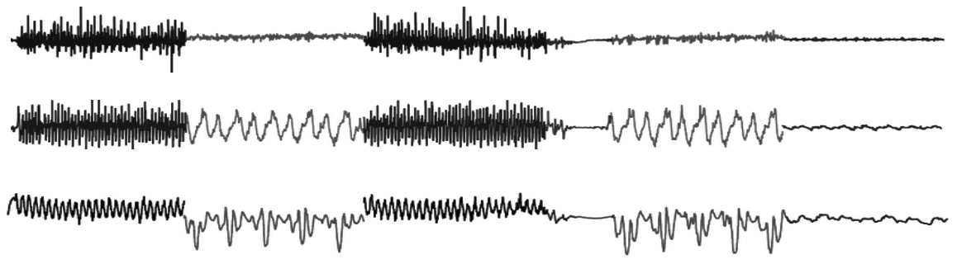
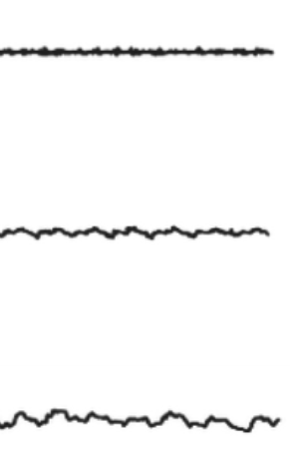
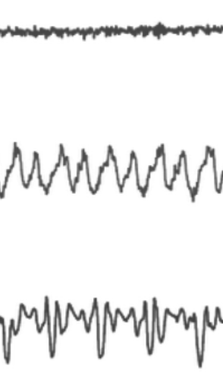

Human Activity Recognition (HAR)
Feature Engineering
Classification
Preprocessing
Segmentation
Feature Engineering
Classification
???
Sensor Data
Feature Engineering
Classification
Activity Segments
Predictions
HAR systems: classify segments of sensor data with activities
Classification quality depends on TS segment
TSS in HAR: Partition TS into activity sequence
Activities typically change in shape
Ermshaus, Schäfer - An Introduction to Machine Learning from Time Series: Time Series Segmentation

Slide 7




Medical Condition Monitoring
Preprocessing
Segmentation
Selection
Analysis
Medical Data
Diagnosis
Medical Condition
Health professionals use medical data to derive medical diagnoses
e.g. cardiology, sleep evaluation, gait analysis
TSS divides biomarker measurements into single medical conditions
Biomarkers typically change in shape
Ermshaus, Schäfer - An Introduction to Machine Learning from Time Series: Time Series Segmentation

Slide 8
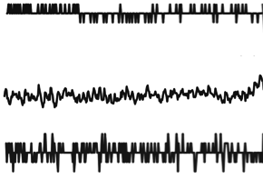

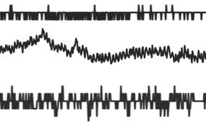
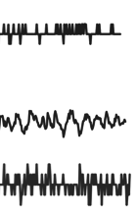
TSS in Smart Manufactoring (IoT)
Preprocessing
Segmentation
Predictive Analytics
IoT Data
Machine States
Dashboard
Dashboards report anomalies and process states from machine sensors
e.g. production lines, power plants, control units
TSS in IoT: segment sensor data into machine states
IoT data often change in distribution
Ermshaus, Schäfer - An Introduction to Machine Learning from Time Series: Time Series Segmentation

Slide 9
Table of Contents
Time Series Segmentation Task & Use Cases
Algorithms
Benchmark Data Sets
Open Problems & Future Work
Ermshaus, Schäfer - An Introduction to Machine Learning from Time Series: Time Series Segmentation

Slide 10
Algorithmic Advances: Selective Overview
Algorithm | Year | Authors | Publication | Python Implementation
BOCD | 2007 | Adams, MacKay | arXiv
PELT | 2012 | Killick, Fearnhead, Eckley | Journal of the American Statistical Association | ruptures
AutoPlait | 2014 | Matsubara, Sakurai, Faloutsos | SIGMOD
EAgglo | 2014 | Matteson, James | Journal of the American Statistical Association | aeon
Wild Binseg | 2014 | Fryzlewicz | The Annals of Statistics | aeon, ruptures
HOG-1D | 2016 | Zhao, Itti | WACV
IGTS | 2017 | Sadri, Ren | Pervasive and Mobile Computing | aeon
FLOSS | 2017 | Gharghabi, Ding, Yeh, Kamgar, Ulanova, Keogh | ICDM | aeon, stumpy
GGS | 2019 | Hallac, Nystrup, Boyd | Adv. Data Anal. Classif. | aeon
KL-CPD | 2019 | Chang, Li, Yang, Póczos | ICLR
ESPRESSO | 2020 | Deldari, Smith, Sadri, Salim | Interact. Mob. Wearable Ubiquitous Technol.
Hidalgo | 2020 | Allegra | Scientific Reports | aeon
TS-CP2 | 2021 | Deldari, Smith, Xue, Salim | WWW
TIRE | 2021 | De Ryck, De Vos, Bertrand | IEEE Signal Processing
ClaSP | 2021 | Schäfer, Ermshaus, Leser | CIKM | aeon, claspy
Last 15 years have seen a wealth of new TSS algorithms
Ermshaus, Schäfer - An Introduction to Machine Learning from Time Series: Time Series Segmentation

Slide 11
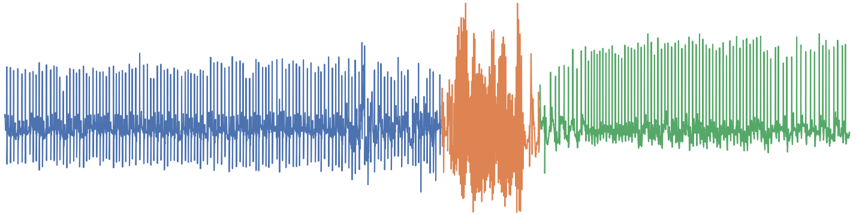
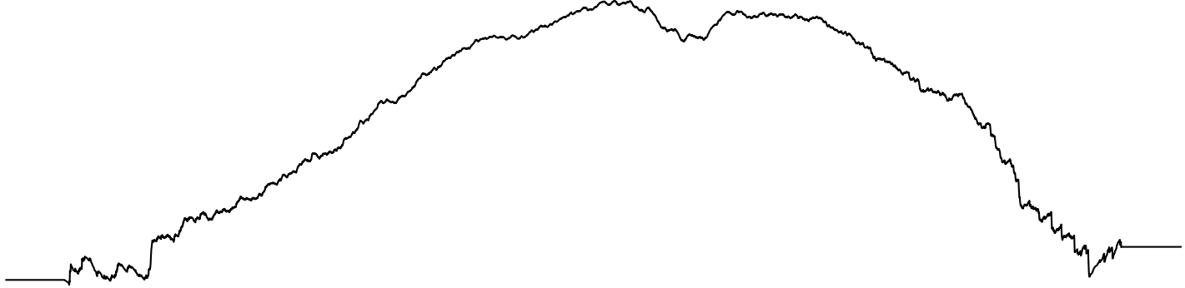
Common Algorithmic Approach
TS
Partitioning algorithm extracts
substantial transitions
Local maxima indicate
process state changes
Score Profile
Two main parts: score profile + partitioning algorithm
Score profile: annotates TS with likelihood of state change
Partitioning algorithm: uses score profile to split TS into segments
Ermshaus, Schäfer - An Introduction to Machine Learning from Time Series: Time Series Segmentation

Slide 12
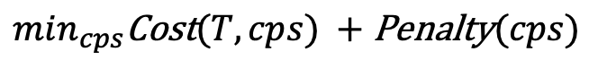
Optimisation Problems
Solve:
$$min_{cps}\text{Cost}(T,cps) +\text{Penalty}(cps)$$
Search
Procedures
Cost
Functions
Constraints
->
+
Dyn. Programming
PELT
(Wild-) BinSeg
Window
L2
Autoregression
Rank
Kernel
predefined
AIC
BIC
MDL
TSS as optimisation problem: minimise summed costs of segments
Locate potential segments, measure their heterogeneity, penalise their amount
Typical framework for changes in distribution
Many specific solutions for different signals
Ermshaus, Schäfer - An Introduction to Machine Learning from Time Series: Time Series Segmentation

Slide 13
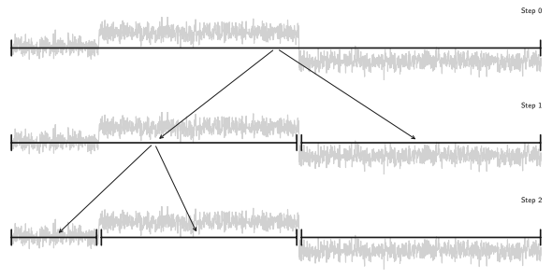
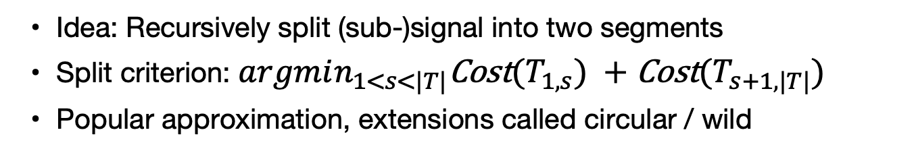
Optimisation Problems: Binary Segmentation
Truong, C., Oudre, L., & Vayatis, N. (2020). Selective review of offline change point detection methods. Signal Processing.
Idea: Recursively split (sub-)signal into two segments
Split criterion: $argmin_{1<s<|T|}\text{Cost}(T_{1,s}) +\text{Cost}(T_{s+1,|T|})$
Popular approximation, extensions called circular / wild
Ermshaus, Schäfer - An Introduction to Machine Learning from Time Series: Time Series Segmentation

Slide 14
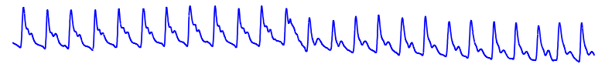
Density of Similar Subsequences
Low density of similar subsequences
across segments
Arc
Change at 2.4k
Aterial blood pressure recording
Gharghabi, S., Yeh, C. C. M., Ding, Y., Ding, W., Hibbing, P., LaMunion, S., ... & Keogh, E. (2019).
Domain agnostic online semantic segmentation for multi-dimensional time series. Data mining and knowledge discovery.
Clustering problem: segments contain mutually similar subsequences
Change points: Transition between groups of similar subsequences
Captures nearest neighbour relationship (density information of arc crossings)
Ermshaus, Schäfer - An Introduction to Machine Learning from Time Series: Time Series Segmentation

Slide 15
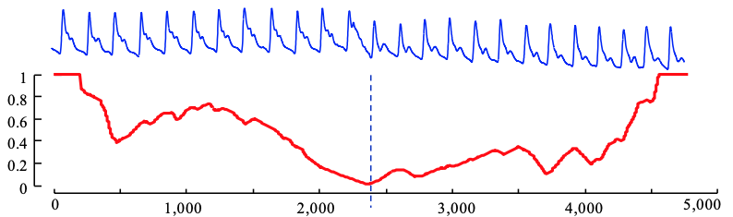
FLUSS: Arc Curve
TS: Reclining man rotated into standing position
Global minimum
captures abrupt shift
Arc Curve Profile
Gharghabi, S., Yeh, C. C. M., Ding, Y., Ding, W., Hibbing, P., LaMunion, S., ... & Keogh, E. (2019).
Domain agnostic online semantic segmentation for multi-dimensional time series. Data mining and knowledge discovery.
Arc curve: number of nearest-neighbour crossings
Idea: Split TS at nearest-neighbour arc curve minima
Equal to the least nearest neighbour crossings
Multivariate / streaming version, ESPRESSO extension
Ermshaus, Schäfer - An Introduction to Machine Learning from Time Series: Time Series Segmentation

Slide 16
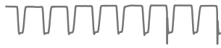
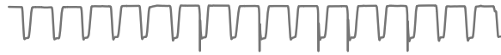
Self-supervised Classification
Class 0
Split 1
Class 1
Cross-Val-F1: 62%
0
0
1
1
1
Class 0
Split 2
Class 1
Cross-Val-F1: 96%
0
0
0
1
1
1
GunPoint hand motion recording
Ratanamahatana, C. A., & Keogh, E. (2005). Three myths about dynamic time warping data mining.
In Proceedings of the 2005 SIAM international conference on data mining (pp. 506-510). Society for Industrial and Applied Mathematics.
Self-supervised Classification: TS segments represent different labels
Find TS splits such that classifier scores high performance on windows
Leverage development of supervised classification for unsupervised problem
Ermshaus, Schäfer - An Introduction to Machine Learning from Time Series: Time Series Segmentation

Slide 17
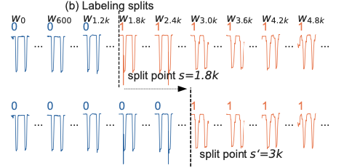
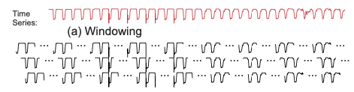
ClaSP: Binary Classification Problem
1
2
Schäfer, P., Ermshaus, A., & Leser, U. (2021). Clasp-time series segmentation. In Proceedings of the
30th ACM international conference on information & knowledge management.
Idea: Create artificial binary subsequence classification problems
Subsequences either belong to segment with class 0 or 1
Efficient enumeration of different labelings
Ermshaus, Schäfer - An Introduction to Machine Learning from Time Series: Time Series Segmentation

Slide 18
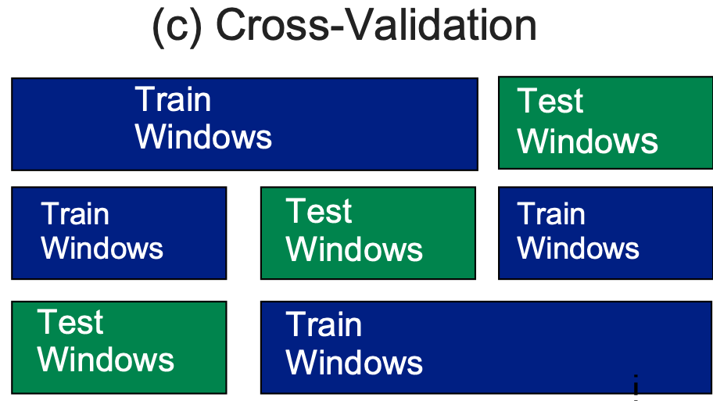
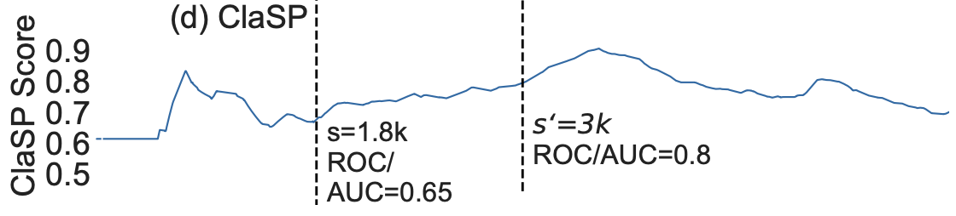
ClaSP: Profile
3
4
Schäfer, P., Ermshaus, A., & Leser, U. (2021). Clasp-time series segmentation. In Proceedings of the
30th ACM international conference on information & knowledge management.
Efficient k-NN classifier relabelling, parameter-free
Profile: cross-validation scores for hypothetical splits
Streaming / multivariate versions, ensembling extension
Ermshaus, Schäfer - An Introduction to Machine Learning from Time Series: Time Series Segmentation

Slide 19
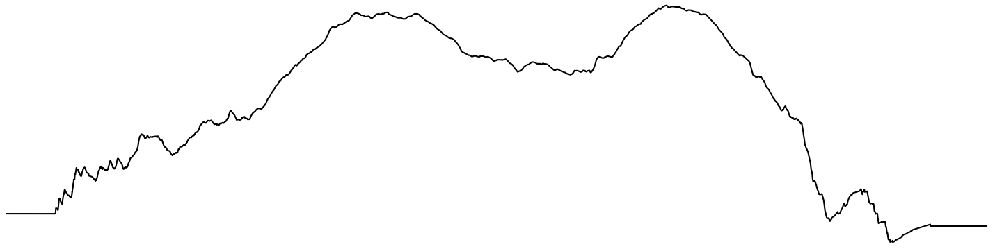
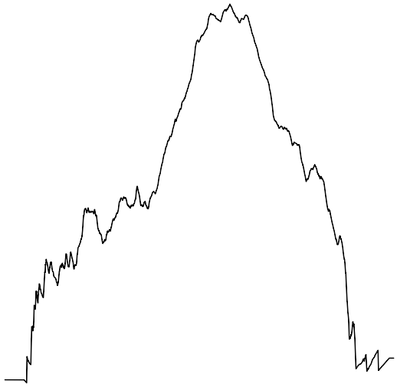
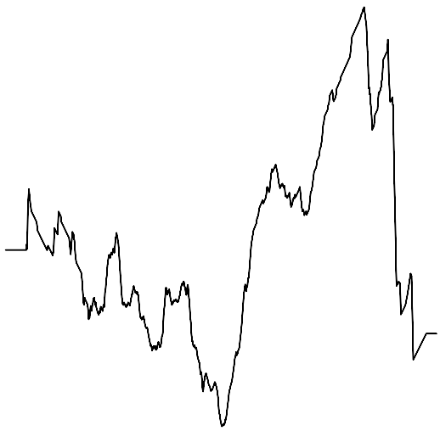
ClaSP: Segmentation
run
walk
jog
valid split at 6.8k
valid split at 3.8k
not
significant
Local maxima in ClaSP indicate CPs candidates
Validate if global maximum is CP with hypothesis testing
Recursively calculate profiles for sub-segments, repeat process
Ermshaus, Schäfer - An Introduction to Machine Learning from Time Series: Time Series Segmentation

Slide 20
Table of Contents
Time Series Segmentation Task & Use Cases
Algorithms
Benchmark Data Sets
Open Problems & Future Work
Ermshaus, Schäfer - An Introduction to Machine Learning from Time Series: Time Series Segmentation

Slide 21
TSS Benchmarks: Selective Overview
Benchmark | Year | Authors | Publication | Domains | Type | # TS | TS size | # Channels | # Segments
UTSA | 2017 | Gharghabi, Ding, Yeh, Kamgar, Ulanova, Keogh | ICDM | Biological, mechanical, synthetic | Semi-Synthetic | 32 | 2k - 40k | 1 | 2 - 3
TCPD | 2020 | Burg, Williams | arXiv | Open data sources | Real Mixed | 42 | 15 - 991 | 1 - 4 | 1 - 23
SKAB | 2020 | Katser, Kozitsin | Kaggle | Machine | Real Sensor Data | 45 | 745 - 1327 | 8 | 2 - 3
TSSB | 2021 | Schäfer, Ermshaus, Leser | CIKM | UCR archive | Semi-Synthetic | 75 | 240 - 20.7k | 1 | 1 - 9
HAS Challenge | 2023 | Ermshaus, AALTD workshop | ECML/PKDD & AALTD | Human activity | Real HAR | 250 | 340 - 42k | 9 | 1 - 15
5 benchmarks released in last years specifically for segmentation
Versatile properties: short/long TS, many domains & change types
Data and evaluations freely available for future research
Ermshaus, Schäfer - An Introduction to Machine Learning from Time Series: Time Series Segmentation

Slide 22
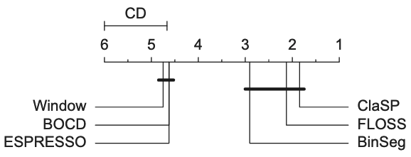
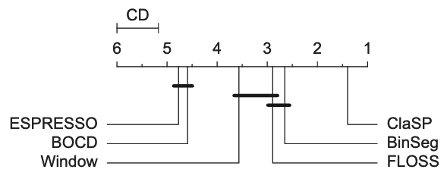
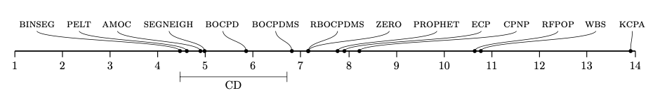
Comparative Evaluations
UTSA (2017/2021)
TSSB (2021)
ClaSP, FLOSS and BinSeg
score state-of-the-art performance
ClaSP significantly outperforms
other competitors
TCPD (2020)
BinSeg, PELT and AMOC
score best performances
BinSeg is a fast, strong baseline
Ermshaus, Schäfer - An Introduction to Machine Learning from Time Series: Time Series Segmentation

Slide 23
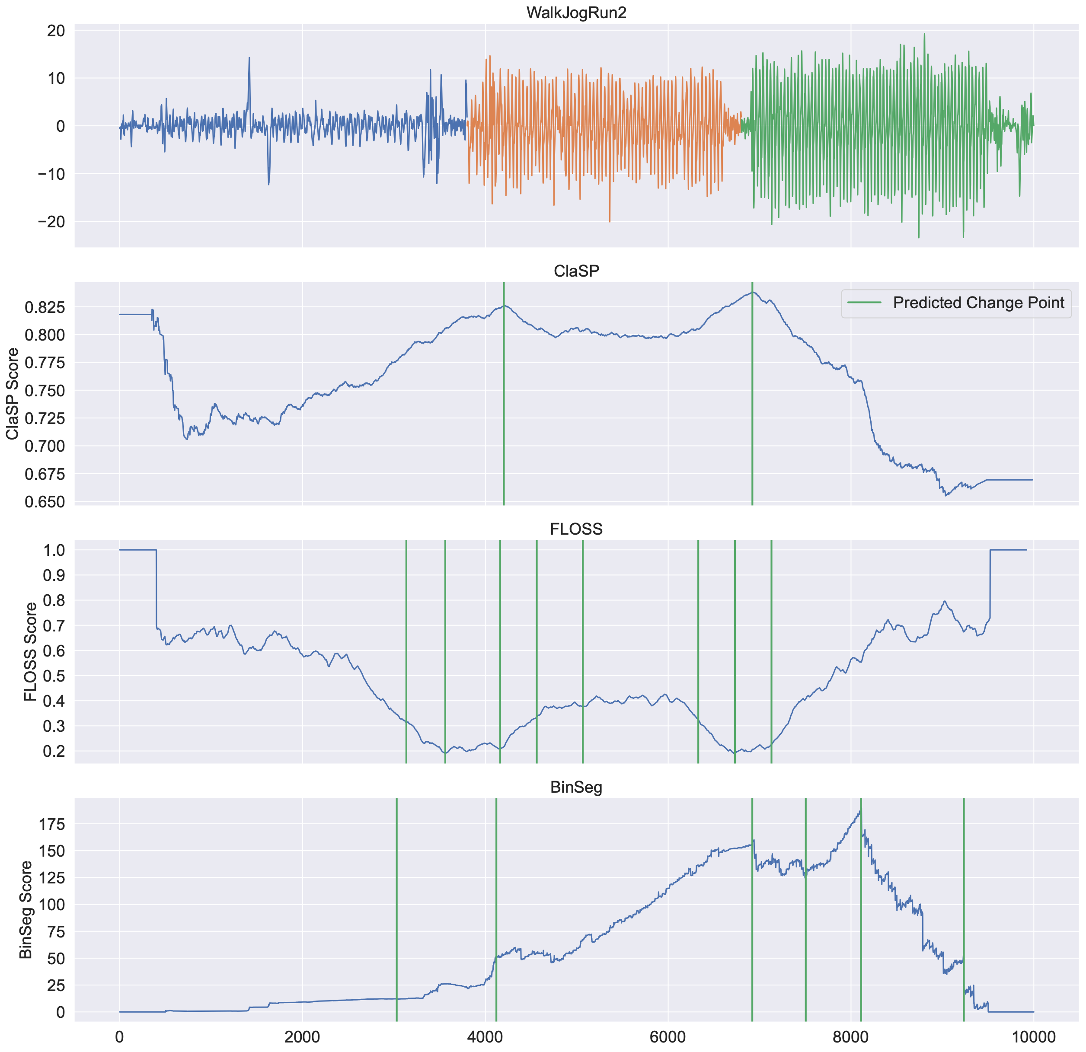
UTSA Use Case: Human Activity Segmentation
Gyroscope of walking, jogging and running
ClaSP correctly segments TS
FLOSS finds change points and nearby false positives (caveat is the local optimum finder)
BinSeg finds change points and noise
Ermshaus, Schäfer - An Introduction to Machine Learning from Time Series: Time Series Segmentation

Slide 24
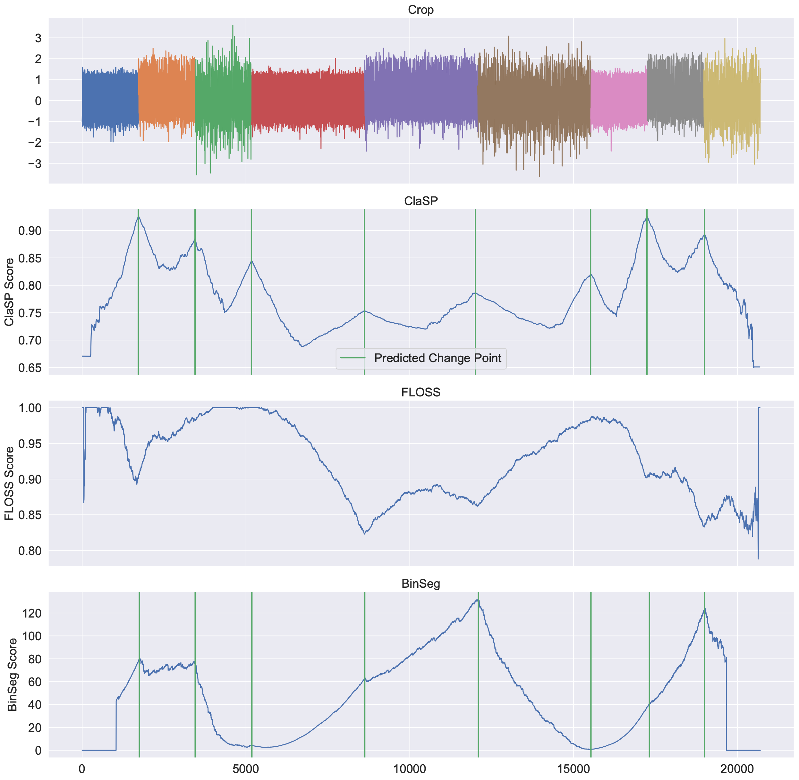
TSSB Use Case: Satellite Image TS
Satellite image TS captures different crops
ClaSP correctly segments TS
FLOSS cannot correctly extract CPs from arc curve (threshold of 0.45 not met)
BinSeg correctly segments TS
Ermshaus, Schäfer - An Introduction to Machine Learning from Time Series: Time Series Segmentation

Slide 25


Open Source Python Implementations
https://www.aeon-toolkit.org/
https://centre-borelli.github.io/ruptures-docs/
Time series machine
learning toolkit
Time series change point
detection toolkit
8 TSS algorithms
6 search methods,
10 cost functions
2 TSS benchmarks
4 data generators
Ermshaus, Schäfer - An Introduction to Machine Learning from Time Series: Time Series Segmentation

Slide 26
Table of Contents
Time Series Segmentation Task & Use Cases
Algorithms
Benchmark Data Sets
Open Problems & Future Work
Ermshaus, Schäfer - An Introduction to Machine Learning from Time Series: Time Series Segmentation

Slide 27
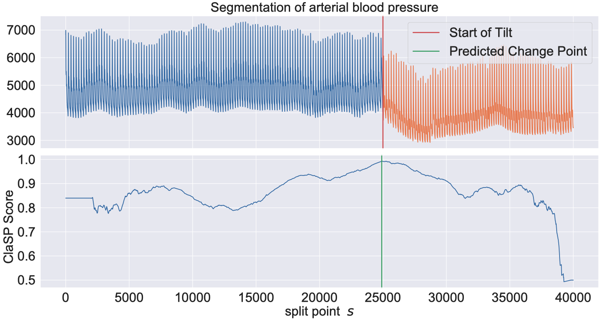
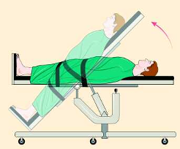
Open Problems: Gradual Transitions
End
Gharghabi, S., et al. (2019).
Domain agnostic online semantic segmentation for multi-dimensional time series. Data mining and knowledge discovery.
Arterial blood pressure of volunteer lying on tilt table, which is rapidly turned up
Sudden rise in blood pressure that slowly drops after reaching upright position
Current TSS algorithms cannot detect gradual decrease
Ermshaus, Schäfer - An Introduction to Machine Learning from Time Series: Time Series Segmentation

Slide 28
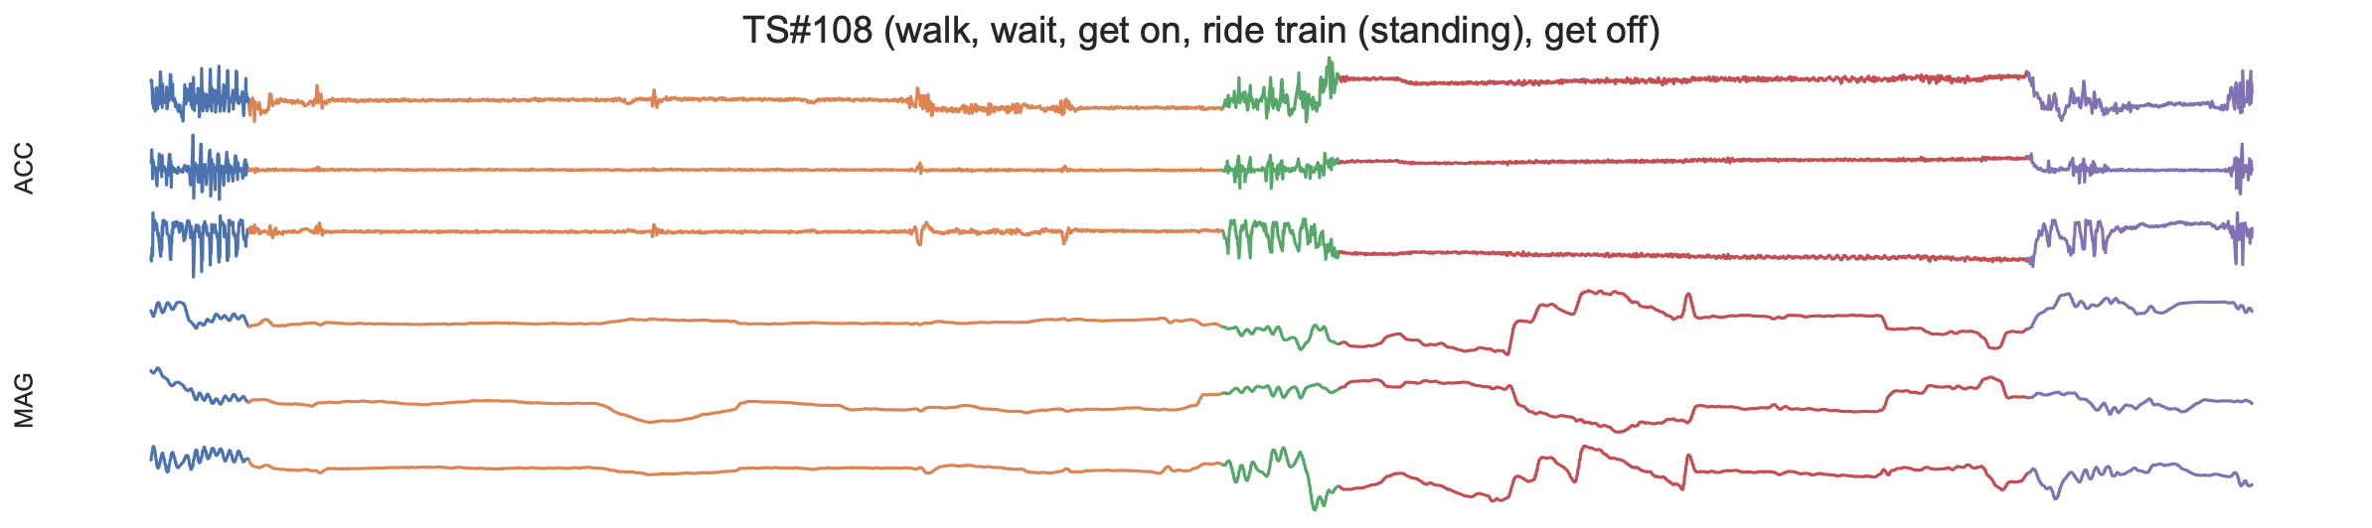
Open Problems: Multivariate Time Series
ClaSP
Ermshaus, A., Schäfer, P., Bagnall, A., Guyet, T., Ifrim, G., Lemaire, V., Leser, U., Leverger, C., & Malinowski, S. (2023). Human Activity Segmentation Challenge @ ECML/PKDD’23. AALTD@ECML/PKDD.
Sensor recordings of student commuting to university by train
Acceleration and magnetometer readings are not consistent
Challenge: select relevant channels for segmentation
Ermshaus, Schäfer - An Introduction to Machine Learning from Time Series: Time Series Segmentation

Slide 29
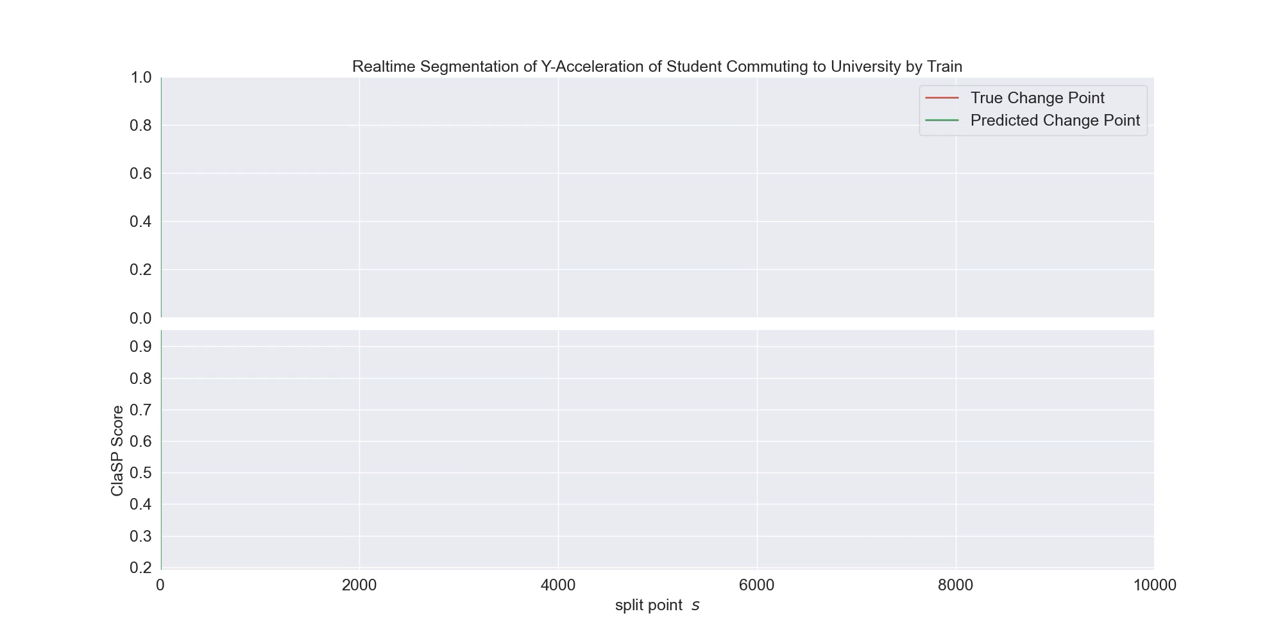
Conclusion and Outlook
TSS: partition TS into homogenous regions
Preprocessing step for advanced knowledge discovery
SoTA algorithms: ClaSP, FLOSS, BinSeg
Challenges: gradual transitions, streaming/multivariate data
TSS is ready to use in
Any questions? Contact us at:
ermshaua@informatik.hu-berlin.de
patrick.schaefer@hu-berlin.de
Thanks for listening!
Ermshaus, Schäfer - An Introduction to Machine Learning from Time Series: Time Series Segmentation

